Slide 1
Political Cartoons: More Than Meets The Eye
How to Interpret the Basic Elements of Political Cartoons

Slide 2
What Are Political Cartoons?
Art form that serves as a source of opinion on society
Express viewpoints on political, economic, or social issues
Make use of humor, symbolism, historical events, and stereotypes

Slide 3

How To Read Them?
Artist’s viewpoint
Symbols
Captions
Humor and Satire
Historical Images

Slide 4
Artist’s Viewpoint:
The purpose of any political cartoon is to express an opinion
What subject or issue is the artist commenting on?
How is the subject portrayed?
What feelings are suggested by the images?

Slide 5
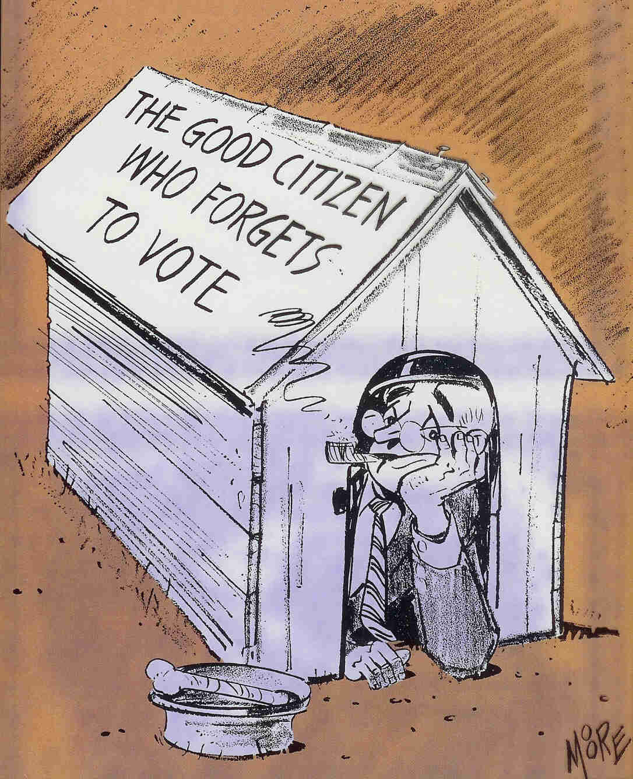
What is the artist’s viewpoint of this cartoon?

Slide 6
What is the artist’s viewpoint of this cartoon?
Voter apathy: People who don’t vote will be in trouble with society.
Heitzmann, W.R. (1980) Political cartoons: Scholastic social studies skills. New York: Scholastic, Inc.

Slide 7
Use of Symbols:
Images that stand for something else
Symbols can stand for objects, places, groups of people, beliefs, character traits, or ideas
Common symbols for our country:
*Uncle Sam=United States
*Set of Scales=Justice or court system
*Dollar bill=Money
Animals used as symbols
*Donkey= the Democratic Party
*Elephant= the Republican Party
*Dove= Peace
*Fox= Sly or untrustworthy

Slide 8




What Do These Symbols Mean?

Slide 9
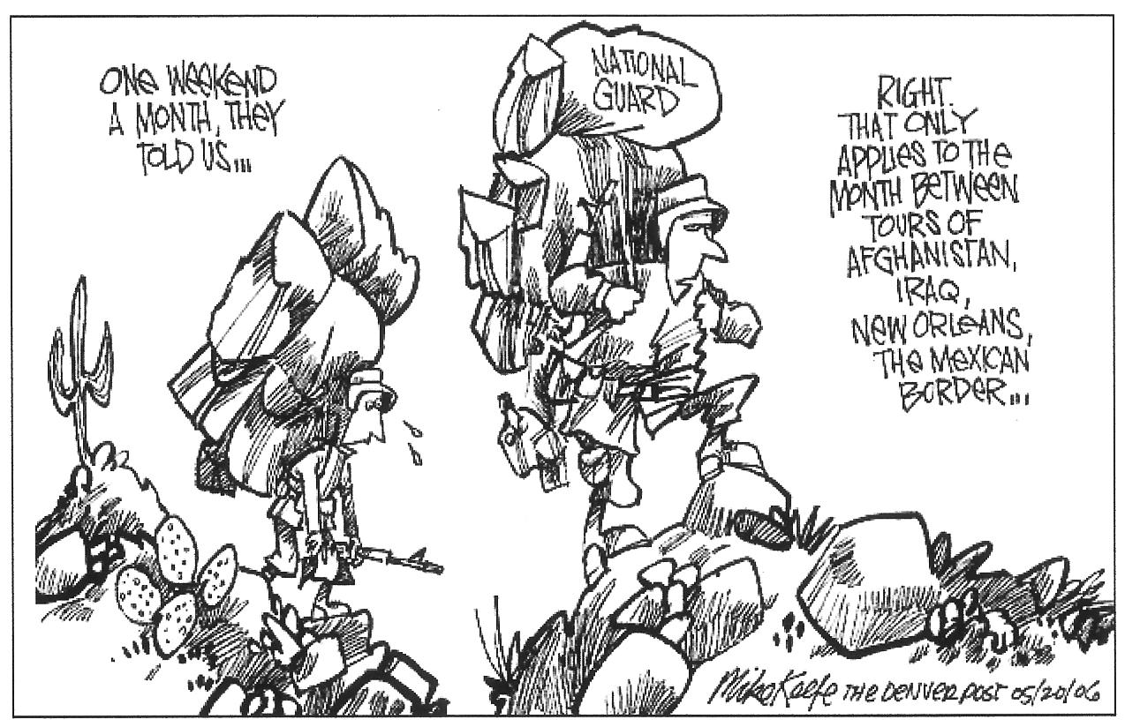
Captions
Can help the reader understand the message, even if the symbols aren’t familiar.
http://www.intoon.com/cartoons.cfm

Slide 10
Humor and Satire
Humor creates interest
Caricature: overemphasis of a person’s features
Irony: saying the opposite of what was really meant
Satire: the portrayal of a wrongdoing to that it becomes the object of ridicule
Stereotype: an oversimplified judgment of a group of people or objects

Slide 11
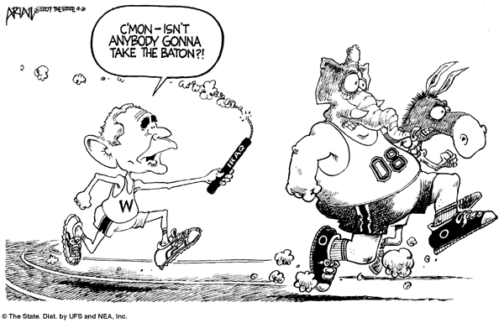
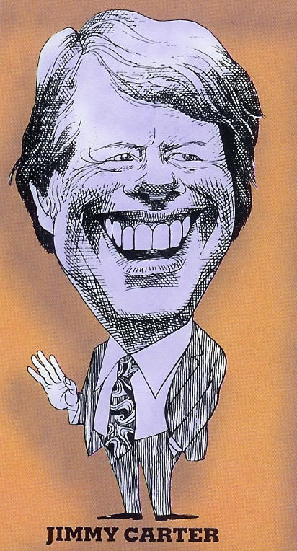
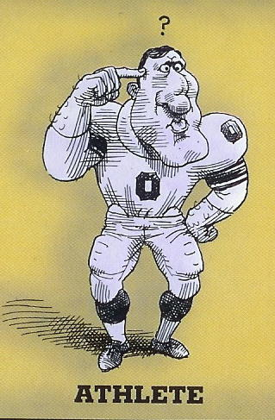
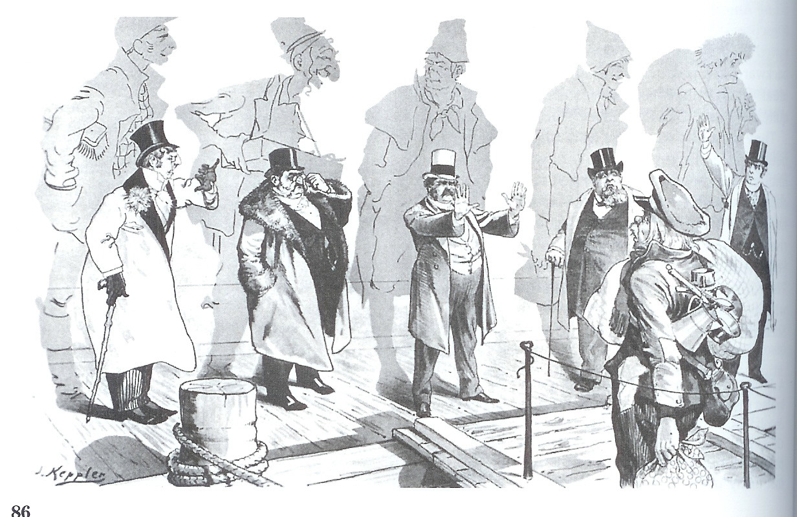
Humor and Satire
http://www.comics.com/editoons/ariail/archive/ariail-20070919.html
Heitzmann, W.R. (1980) Political cartoons: Scholastic social studies skills.
New York: Scholastic, Inc.
Heitzmann, W.R. (1980) Political cartoons: Scholastic social studies skills.
New York: Scholastic, Inc.
Hakim, J. (1993). A history of us: An age of extremes. New York: Oxford
University Press.

Slide 12
Historical Images
Artists include historical or literary images to help express viewpoints on current issues
Recognizing the historical or literary images is necessary to understand the meaning of the cartoon

Slide 13
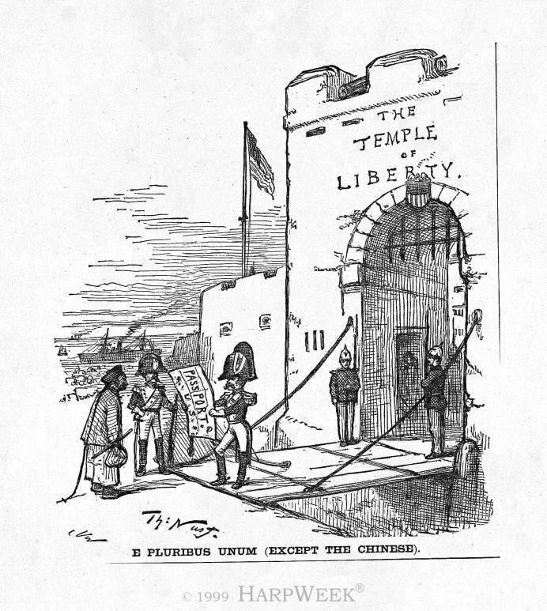
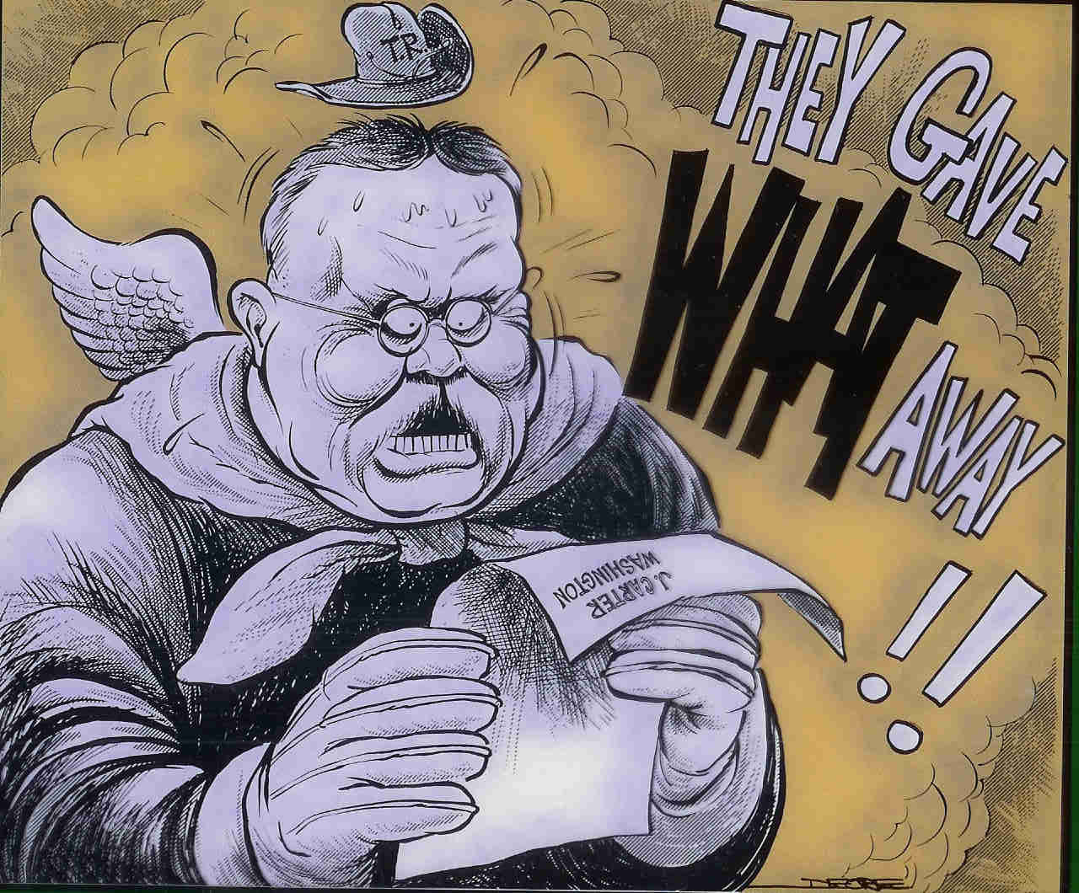
Historical Images
Heitzmann, W.R. (1980) Political cartoons: Scholastic social studies skills. New York: Scholastic, Inc.
http://www.immigrants.harpweek.com/ChineseAmericans/Illustrations/
078EPluribusUnumMain.htm
The angel of Teddy Roosevelt reacting to the news that Pres. Carter would turn over the control of the Panama Canal to the Panamanian government in 1999.
Soldiers “guarding” the entrance to the United States to all immigrants except the Chinese following the Chinese Exclusion Act of 1882.

Slide 14
How Will We Use Cartoons?
Understand public opinion of a particular time period
Examine opposing views
Compare historical and contemporary issues

Slide 15
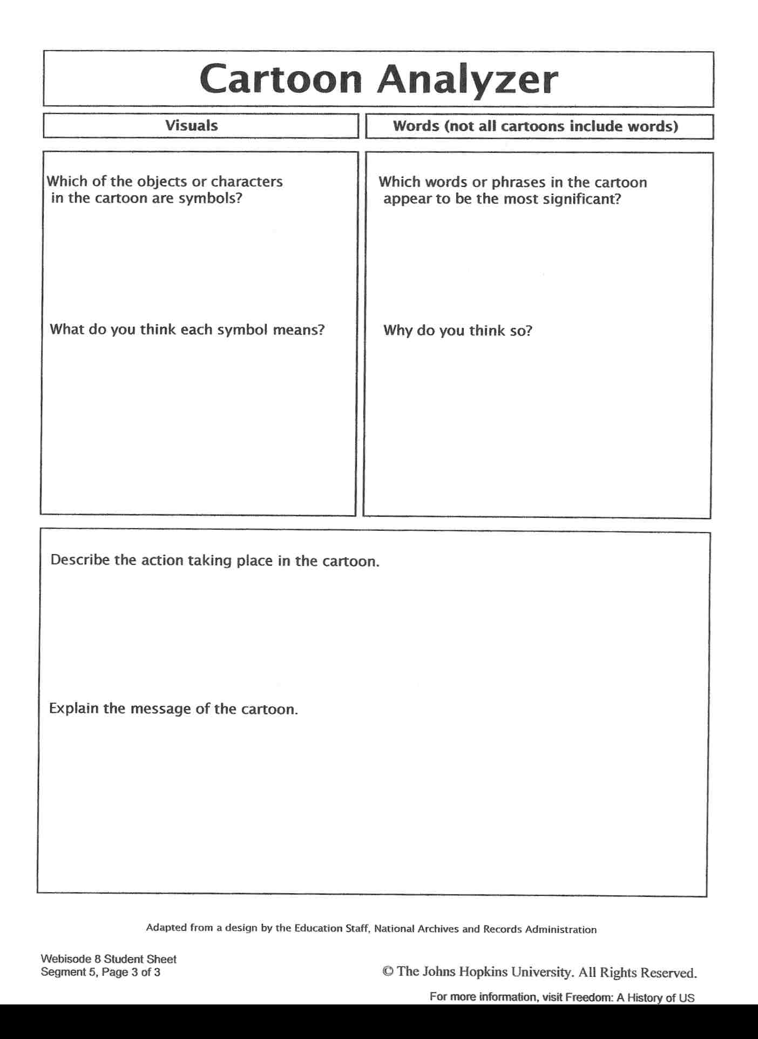
Cartoon Analysis worksheet: http://www.pbs.org/wnet/historyofus/teachers/pdfs/segment8-5.pdf?mii=1

